Slide 1


SAS(5483TT)
2025 Q2 Earnings Calls
2025/08/08
©Sino-American Silicon Products Inc. All rights reserved.

Slide 2
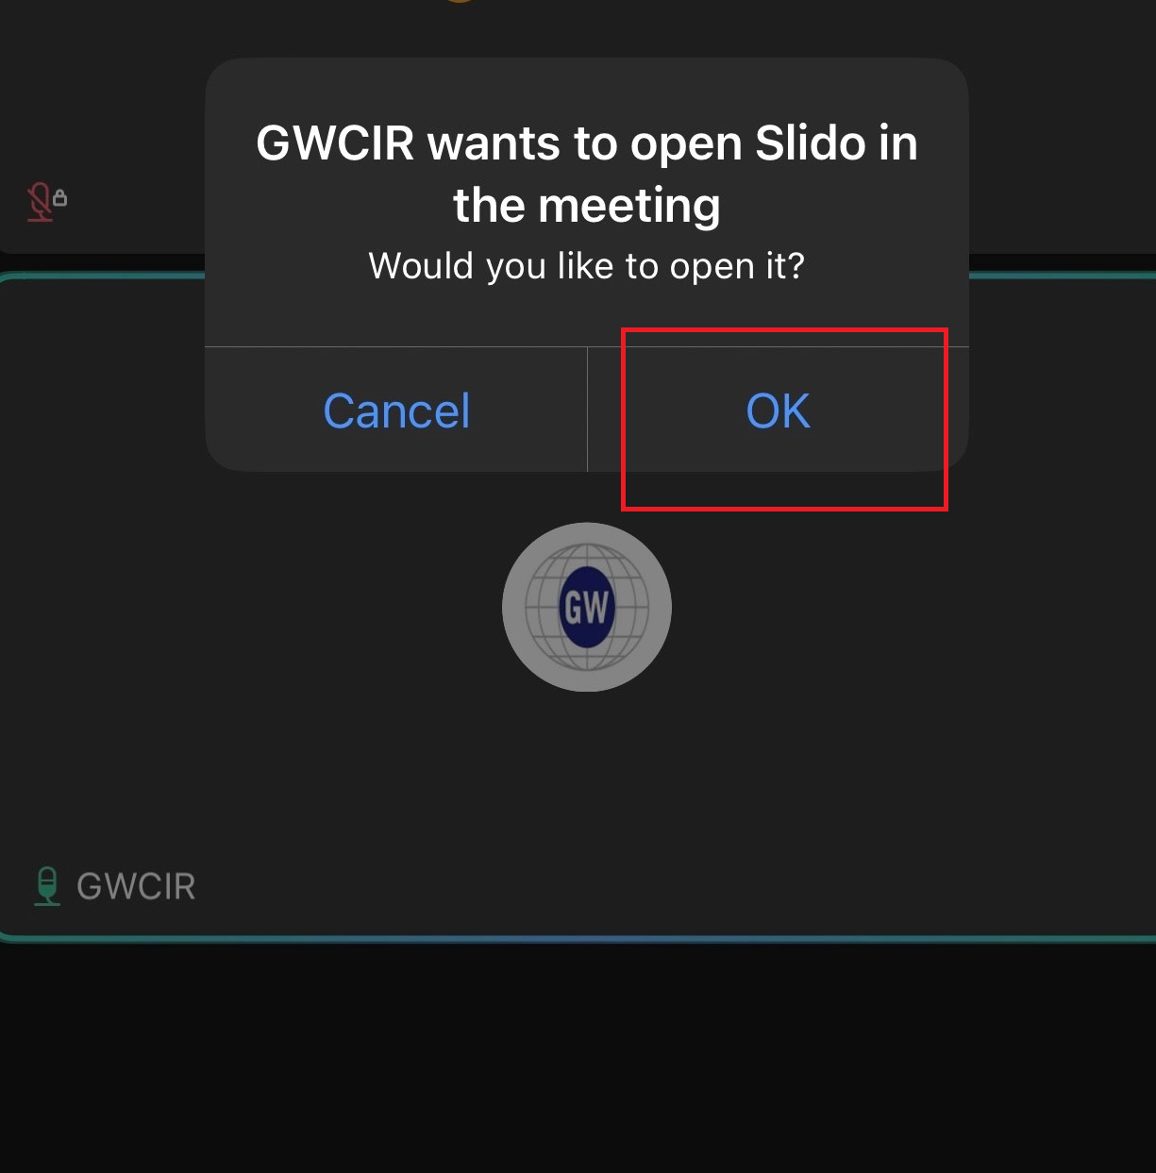
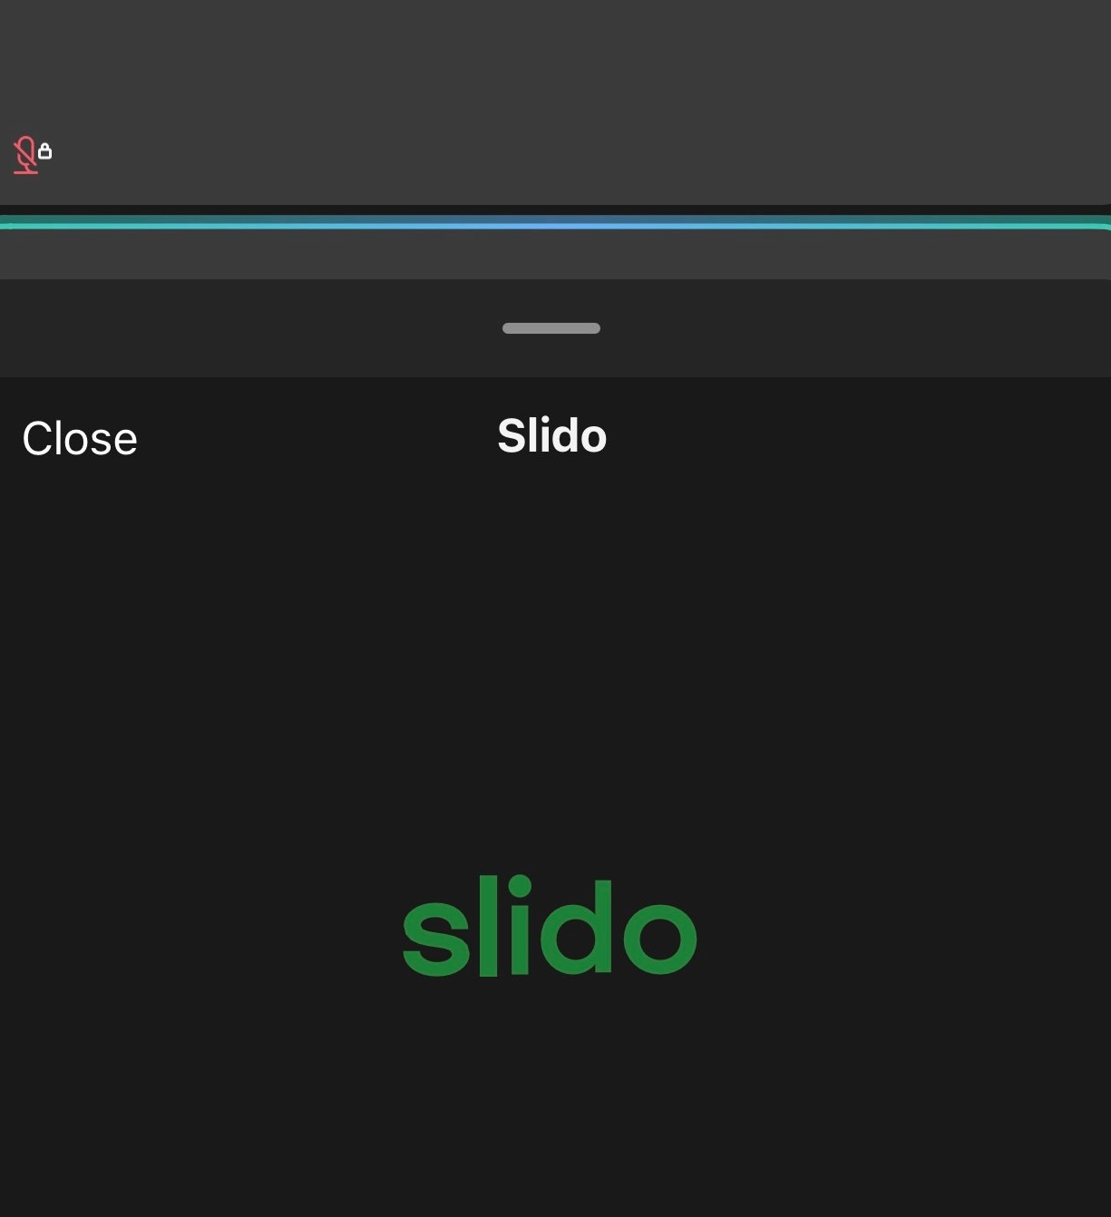
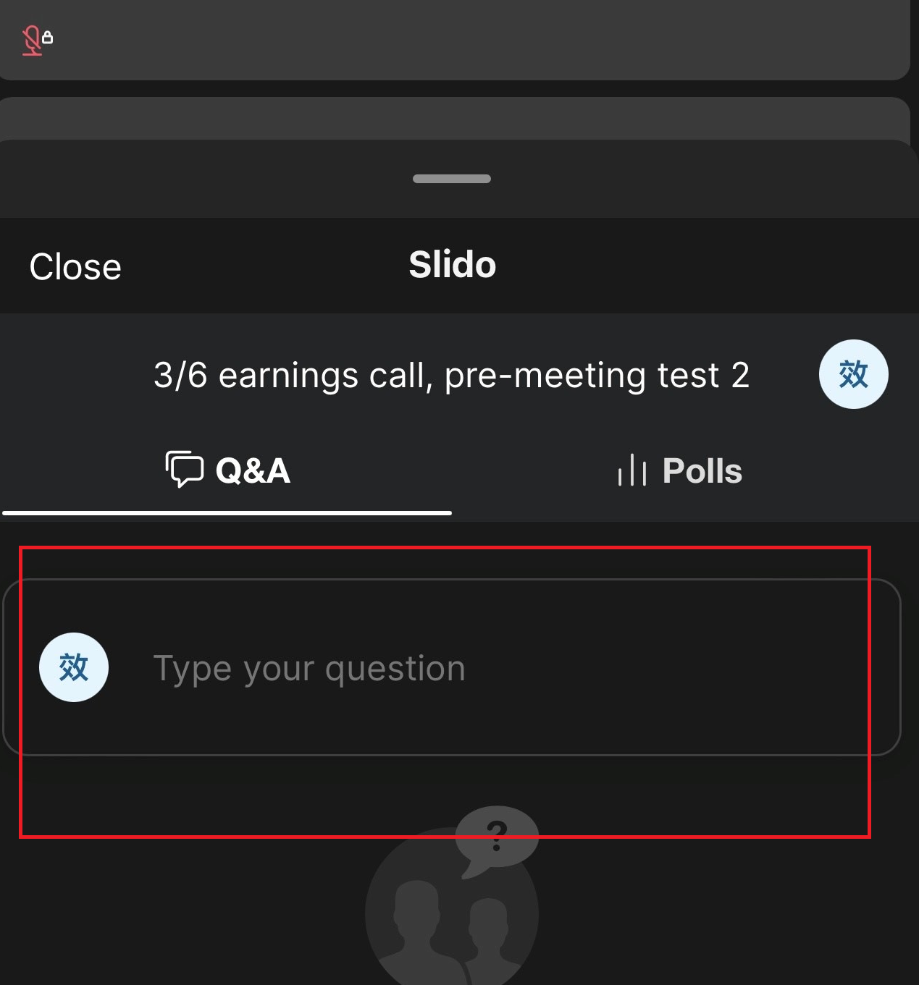
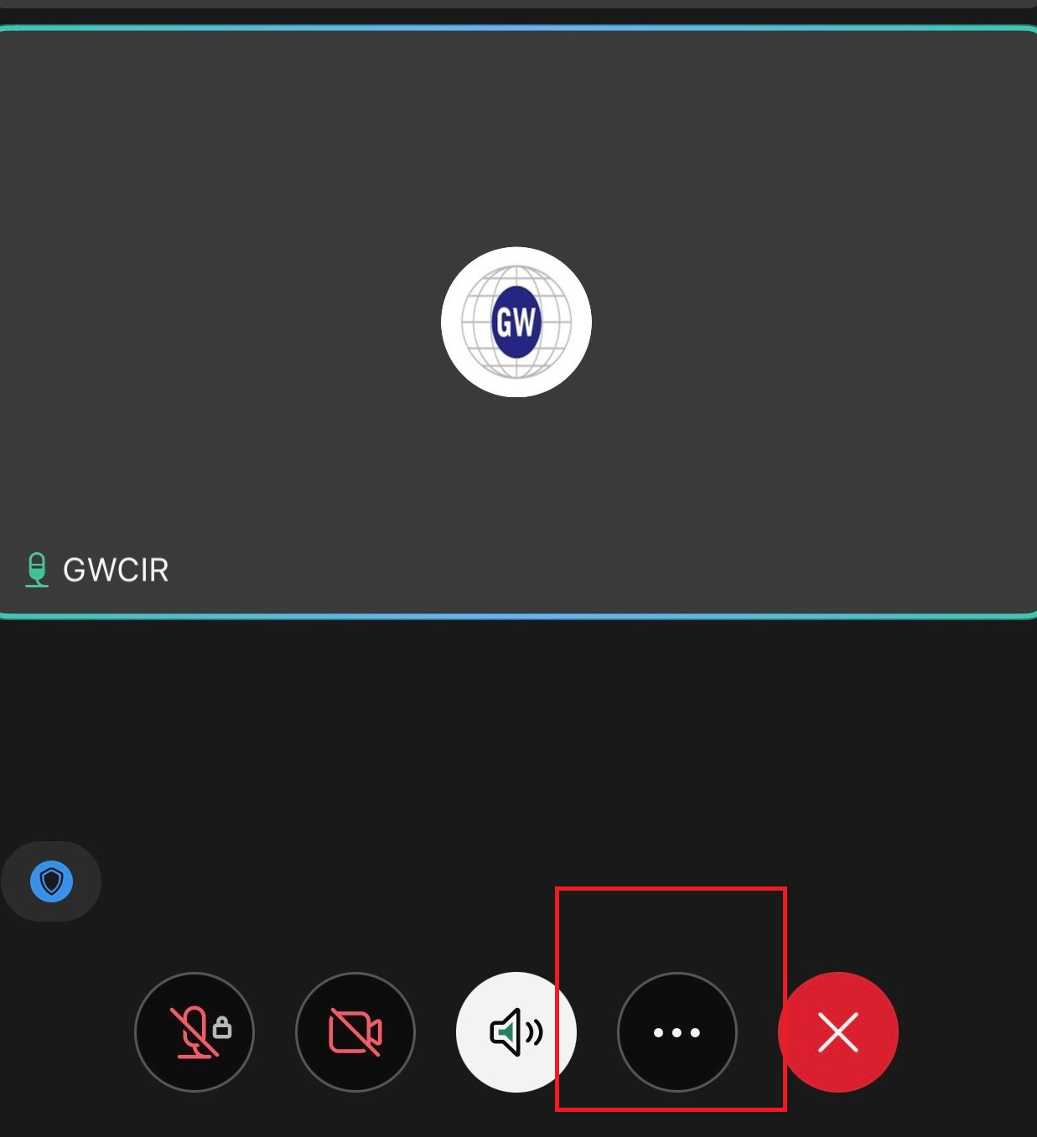
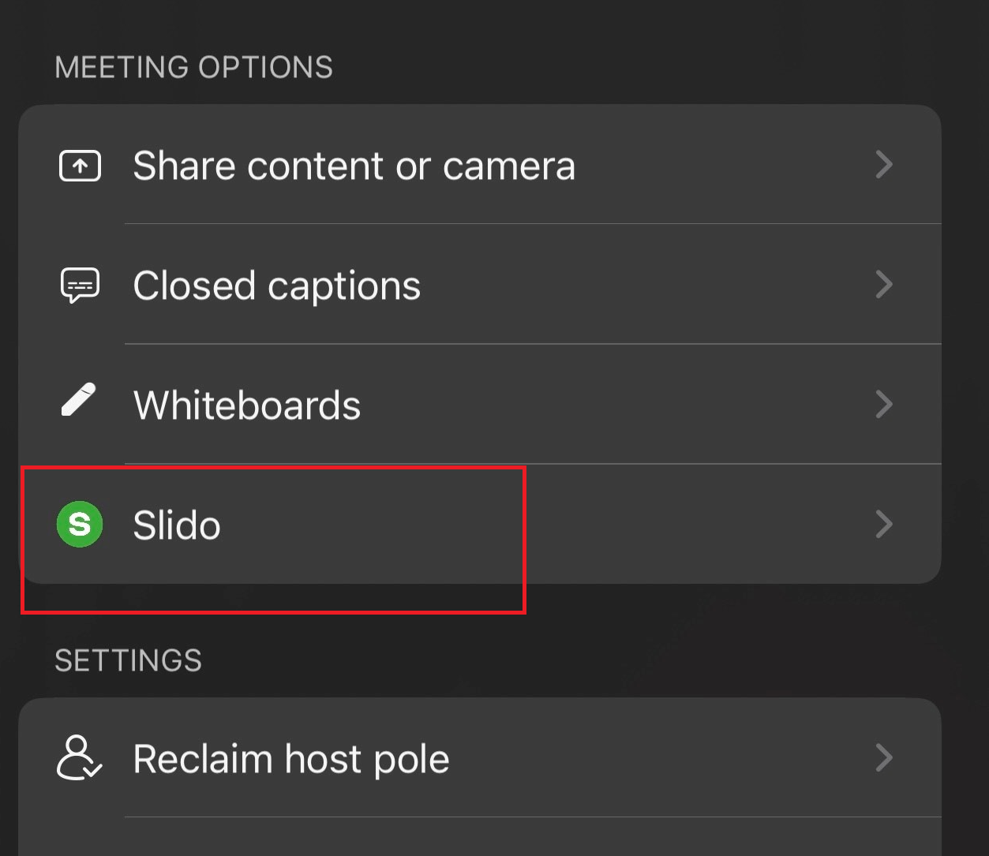
Q&A via Slido
Step1 Step2 Step3
2. A Slido interface will be presented.
1. Click OK upon seeing "GWCIR wants
to open Slido in the meeting“.
3. Input your questions.
If you exit Slido and wish to re-enter the platform:
Please note：
1. Inputting questions in English is suggested.
2. Sending all questions in one go is suggested.
3. Questions will be taken during the Q&A session.

Slide 3
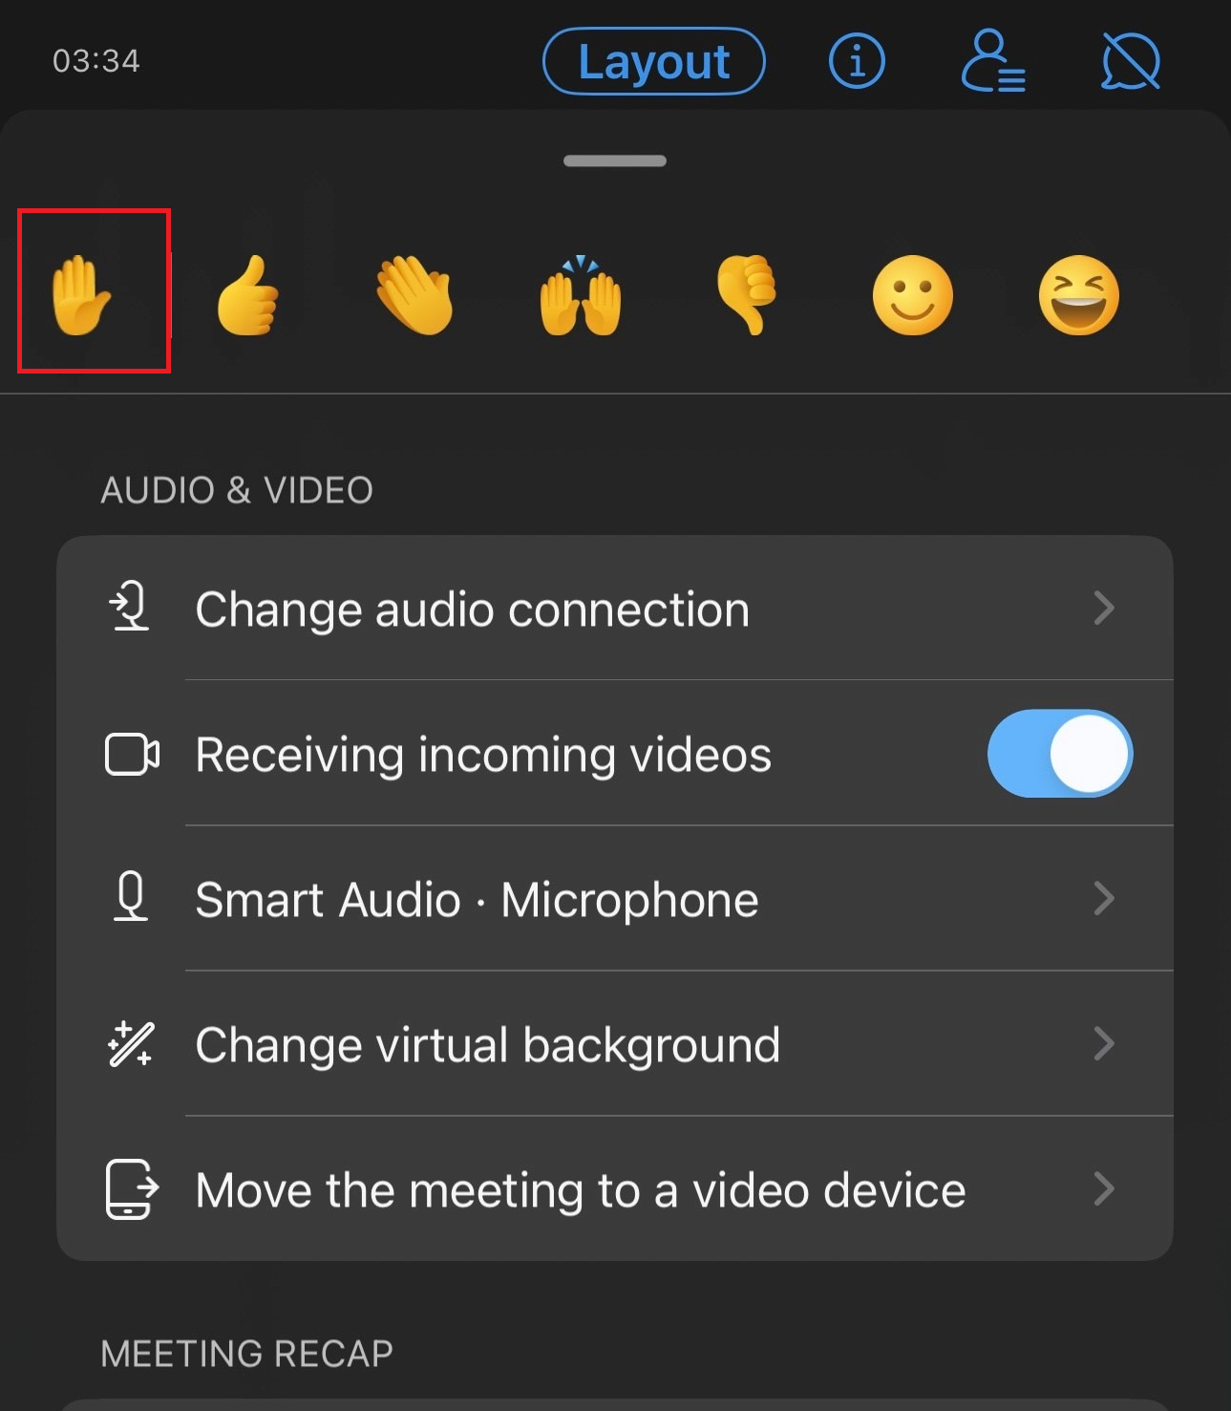
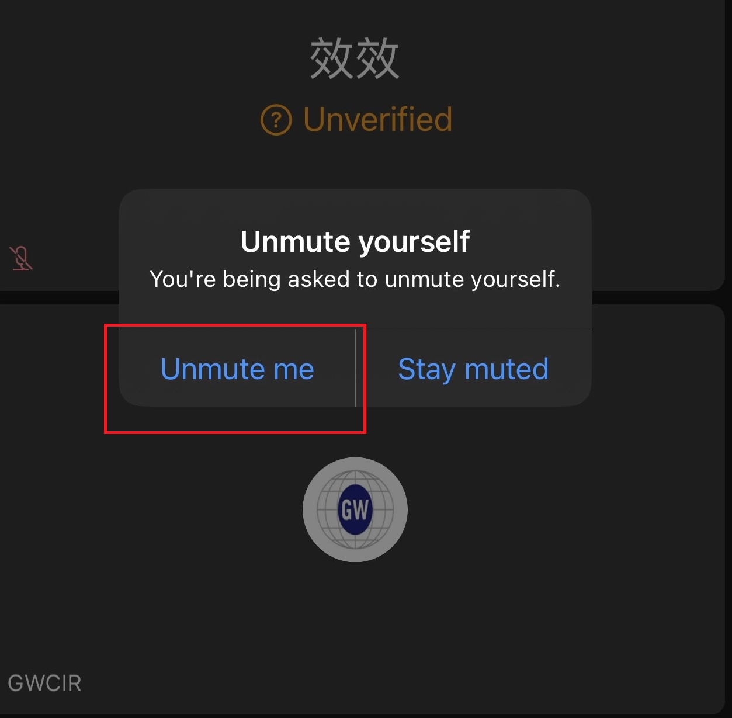
Q&A via Audio
Step1 Step2 Step3
Click on the icon with three dots on the lower right.
Click “Raise your hand" on the upper left.
Unmute yourself to ask questions upon receiving our invitation.
Please note：
Questions will be taken during the Q&A session.

Slide 4

Disclaimer
This presentation has been prepared by Sino-American Silicon Products Inc. (the “Company”). This presentation and the materials provided herewith do not constitute an offer to sell or issue or the solicitation of an offer to buy or acquire securities of the Company in any jurisdiction or an inducement to enter into investment activity, nor may it or any part of it form the basis of or be relied on in connection with any contract or commitment whatsoever. Any decision to purchase securities in a proposed offering should be made solely on the basis of the information contained in the offering circular published in relation to such proposed offering, if any.
The information contained in this presentation has not been independently verified. No representation, warranty or undertaking, express or implied, is made as to, and no reliance should be placed on, the fairness, accuracy, completeness or correctness of the information or the opinions contained herein. The information contained in this document should be considered in the context of the circumstances prevailing at the time and has not been, and will not be, updated to reflect material developments which may occur after the date of the presentation. None of the Company nor any of its affiliates, advisors or representatives will be liable (in negligence or otherwise) for any loss howsoever arising from any use of this presentation or its contents or otherwise arising in connection with the presentation.

Slide 5

01
Executive Comment
©Sino-American Silicon Products Inc. All rights reserved.

Slide 6
Executive Comments
1. Financial Highlights
Revenue
Q225 → NT$20.2 billion, 4.43% QoQ, third highest over the same period
1H25 → NT$39.6 billion, 0.04% YoY, second highest over the same period
Revenue(USD)
Q225 → US$0.66 billion, 11.5% QoQ
1H25 → US$1.25 billion, 0.3% YoY
Gross Profit %
Q225 → 25.3%
1H25 → 25.7%
Operating Income %
Q225 → 14.0%
1H25 → 14.5%
4

Slide 7
Executive Comments
Financial Highlights
Net Profit %
Q225 → 8.5%
1H25 → 8.9%
EPS
Q225 → NT$ 1.17
1H25 → NT$ 2.37
5

Slide 8
Executive Comments
2. Renewable Energy Industry Overview
Global
Despite geopolitical tensions and economic uncertainty, global energy investment is projected to reach USD 3.3 trillion in 2025, a 2% increase from 2024. Around 2.2 trillion will go to clean energy, double the amount for fossil fuels, highlighting the accelerating shift toward a low-carbon future.
Over the past five years, investment in low-emissions power has grown significantly, with solar PV taking the lead. In 2025, global solar PV investment is projected to reach USD 450 billion. The widespread availability of low-cost imported solar PV modules, has become a key driver of energy investment in many emerging markets. Battery storage investment is also expected to rise to USD 66 billion, supported by increasing electricity demand from data centers.
Taiwan
Taiwan aims to achieve 30% renewable energy by 2030 and net-zero emissions by 2050. To meet the 2030 target—solar PV (31.2 GW) and offshore wind (10.9 GW)—Taiwan must add an average of 2.82 GW of solar and 1.17 GW of offshore wind capacity annually from 2025 to 2030. Besides, the target for solar PV installation capacity in 2026 is 20GW.
6

Slide 9
Executive Comments
3. SAS Business Strategy
SAS is a conglomerate with footprints spanning across semiconductor, automotive electronics, and renewable energy. Through an active investment strategy and its ability to identify high-potential companies in the past decades, it has successfully established an increasingly balanced and diversified business portfolio
Semiconductor / Automotive Electronics
By forging strategic alliances upstream and downstream, SAS has built a competitive industry chain layout. Its international capacity and semiconductor network continue to fuel group growth
Renewable Energy
In addition to our original manufacturing department, SAS has expanded into a light asset service such as renewable energy sales, energy storage management and energy service company, preparing for the future growth
SAS fosters synergistic collaborations with its key group companies, facilitating mutual expansion of operational scope and driving the continued growth of both SAS and its affiliates
Key Group Company⁵ | 1H25 Revenue (NT$ mn) | YoY | Basic EPS
GlobalWafers | 31,602 | 3.9% | NT$6.56
Actron¹ | 4,280 | 16.2% | NT$2.70
AWSC² | 1,746 | -32.7% | NT$0.92
TSC³ | 482 | 19.2% | NT$1.49
Mosel Vitelic⁴ | 1,077 | 30.25% | -NT$0.20
Note: 1. Actron: Actron Technology
2. AWSC: Advanced Wireless Semiconductor Company
3. TSC: Taiwan Specialty Chemicals Corporation
4. Mosel Vitelic was consolidated into Actron Technology in June 2023
5. Please refer to the page(p.17) for operating information of key group companies.
7

Slide 10

Executive Comments
3. SAS Business Strategy-Strengthens Comprehensive Semiconductor Strategy
SAS, through its affiliated company TSC, indirectly acquired 65.22% equity stake in Hung Jie Technology Corporation, a Taiwan-based provider of semiconductor equipment component cleaning and refurbishment services. Doris Hsu, Chairperson of the SAS Group, would be the role of Chairperson of Hung Jie, working closely with the existing professional management team to leverage the Group’s integrated strengths in materials and process services, and jointly expand opportunities in the advanced semiconductor manufacturing market.
By leveraging its global footprint, sales networks, and management expertise, SAS collaborates with affiliated companies to strengthen strategic alignment and operational resilience.
About Hung Jie Tech.
Date of Registration
2008/5/15
Operation Locations
Hsinchu and Tainan, Taiwan,
as well as Nanjing, China
Strengthen the comprehensive support for semiconductor customers
Enhance one-stop solution capabilities—from specialty gases to surface precision treatment, UHP cleaning, and refurbishment of equipment components.
Broaden the critical semiconductor materials and process support capabilities, aiming to meet the rising demand for precision in advanced nodes driven by AI and high-performance computing.
Doris Hsu
Representative
Shareholding Structure
65.22% indirectly¹ hold by SAS
Business items
Ultra-High Purity (UHP) cleaning and inspection; precision surface processing (coating); and refurbishment of advanced semiconductor equipment components
Source: SAS Internal intelligence
Note: 1. SAS holds a 28.52% equity stake in TSC; TSC hold a 65.22% equity stake in Hung Jie Tech.
8

Slide 11
Executive Comments
3. SAS Business Strategy-Strengthens Comprehensive Semiconductor Strategy
The following table shows the proposed consolidated financial statement¹ of TSC and Hung Jie Tech. for FY2024 and 1H25:
Income Statement (NT$Mn) | 1H25 |  | 2024
 | Amount | % of Revenue | Amount | % of Revenue
Revenue¹ | 1,472 |  | 2,412
Gross Profit¹ | 776 | 52.7% | 1,172 | 48.6%
Operating Income¹ | 583 | 39.6% | 830 | 34.4%
Net profit before tax¹ | 594 | 40.3% | 862 | 35.7%
Net Profit¹ | 478 | 32.5% | 756 | 31.4%
EPS¹ | NT$2.43 |  | NT$4.24
Net income attributable to | Amount | % of Revenue | Amount | % of Revenue
Owners of parent¹ | 359 | 24.4% | 597 | 24.8%
Non-controlling interests¹ | 119 | 8.1% | 160 | 6.6%
Notes: 1. The proposed consolidated financial statement is prepared in accordance with International Financial Reporting Standards (IFRS) and are consolidated with the financial statement of Hung Jie Tech. Hung Jie‘s individual financial statement is prepared independently in accordance with Enterprise Accounting Standards (EAS) and has not been audited or reviewed by a certified public accountant. In preparing the proposed consolidated financial statement necessary adjustments and restatements have been made to Hung Jie’s individual financial statement in accordance with International Financial Reporting Standards (IFRS) to conform to the requirements of the proposed consolidation basis.
9

Slide 12
Executive Comments
3. GlobalWafers
Revenue
Q225 → NT$16.0 billion, 2.7% QoQ, the third highest over the same period !​
1H25 → NT$31.6 billion, 3.9% YoY, the third highest over the same period !
Gross Profit %
Q225 → 25.8%​
1H25 → 26.1%
Operating Income %
Q225 → 15.2% ​
1H25 → 15.9%
10

Slide 13
Executive Comments
3. GlobalWafers
Net Profit %
Q225 → 10.5% ​
1H25 → 9.9%
EPS
Q225 → NT$3.52 ​
1H25 → NT$6.56
Prepayment​
NT$27.3 billion (US$0.93 bn)¹ ​
Note: 1. FX Rate: NTD:USD = 29.3, including guarantee
11

Slide 14
Executive Comments
3. GlobalWafers
Global Economy
Global economic growth is projected to slow from 3.4% in 2024 to 2.9% in both 2025 and 2026, amid tighter financial conditions, persistent trade policy uncertainty, and declining business confidence according to OECD.
Elevated manufacturing costs are likely to drive inflation, which may weigh on consumer spending and pose selective downside risks to parts of the semiconductor market.
Semiconductor Industry
Structural Growth Intact: Long-term demand remains solid across AI, robotics, healthcare, and renewable energy, supporting sustained growth in advanced wafers and materials. GlobalWafers is well-positioned to capture this upcycle through its globally integrated, locally adaptive capacity expansion strategy.
Inventory Normalization: Downstream inventory is stabilizing with early recovery signs, though the pace may remain gradual amid ongoing macro and trade uncertainties.
External Risks: Geopolitical tensions, tariffs (including retaliatory measures and Section 232), and FX volatility continue to pressure supply chains and weigh on investor sentiment.
12

Slide 15
Executive Comments
3. GlobalWafers
GlobalWafers’ Growth Strategy and Fiscal Health
GlobalWafers has begun sample shipments from its U.S. and Italy capacity expansions, enhancing regional presence with new 300mm advanced and SOI wafer capabilities. U.S.-produced products are gaining traction, highlighting strong execution and rising demand for local supply, with revenue contributions expected to ramp gradually from 2H25 through 1H26.
Brownfield projects demonstrate robust performance, marked by record shipment in Japan and Taiwan, and stellar performance in Denmark. With 18 production sites across 9 countries and a customer-centric supply chain, the company is well-positioned to navigate the complex macroeconomic and policy landscape.
13

Slide 16
Executive Comments
3. GlobalWafers
GlobalWafers’ Growth Strategy and Fiscal Health (Cont.)
Alongside strong GaN demand and ongoing specialty wafer development, we are accelerating our strategic pivot toward high-value specialty wafers (SiC, SOI, GaN, Float Zone), while expanding our 300mm production capacity. Upon completion of the capacity expansion, 300mm wafers are expected to account for nearly two-thirds of total revenue, significantly boosting profitability and reinforcing our technological leadership.
Amid ongoing global expansion, our interest-bearing debt¹ declined to NT$67,343M (–6.4% QoQ), while the current and quick ratios improved to 135% and 113%, respectively. The strengthened total liabilities-to-assets ratio of 58.9% (32.6% including only interest-bearing debt¹) further underscores our solid balance sheet. We anticipate a recovery supported by subsidies, ramping revenue, and a resilient global footprint amid ongoing uncertainties.
14

Slide 17
02
Company Overview
15
©Sino-American Silicon Products Inc. All rights reserved.

Slide 18






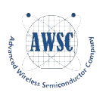



Strategic Enabler to Enhance Group Synergies
Renewable
Energy
Semiconductors
SUN
Anneal Energy (Anneal)
Sustainable
Sunrise
SGE¹
Automotive
Components
Taiwan Speciality
Chemicals Corporation
(4772:TT)
Susen Green Energy
GlobalWafers
(6488:TT)
Sustainable Energy Solution
SAS’s Role and Responsibilities
Group Strategy Leader
Operational Optimization
Global Expansion Enabler
Sustainable Energy Catalyst
Investment & JV Driver
Technology & Talent Synergy
Integrated supply chain enables agile market response
Hung Jie
Technology Corporation
Advanced Wireless
Semiconductor Company
(8086:TT)
Actron Technology
Corporation
(8255:TT)
Mosel Vitelic
(2342:TT)
Note: 1. Change of company name: the original name of Susen Green Energy Co., Ltd.(SGE) is known as Sunrise PV Three Co., Ltd.(SPV3).
2. Please refer to the next page(p.17) for operating information of important group companies.
16

Slide 19



Strategic Enabler to Enhance Group Synergies
Leveraging SAS critical resources allocation across key group companies in terms of global network, sales channel, and management expertise to optimize mutually beneficial group synergies.
Empowering respective group companies to elevate their strategic vision and enhance their growth momentum.
Embracing more promising companies to enlarge the ecosystem.
(8255:TT)
(6488:TT)
50%+
Auto LLD Market Share
No.3
Semiconductor Wafer Manufacturer
(4772:TT)
Only 2
Globally Recognized Trisilane Manufacturing Technologies
Automotive
Components
(8086:TT)
(SES)
Semiconductors
No.2
GaAs Foundry Company with 20%+ Market Share
SUN
Best Partner for Green Energy & High Power Demand
(Sustainable
Sunrise)
Renewable
Energy
Advanced Equipment Cleaning & Inspection
Renewable Energy Production Business Business
(Anneal)
SGE¹
(2342:TT)
Best Partner for
Type III Site Companies²
(Susen Green Energy)
High-Efficiency Power Devices Provider
Renewable Energy Production Business
Note: 1. Change of company name: the original name of Susen Green Energy Co., Ltd.(SGE) is known as Sunrise PV Three Co., Ltd.(SPV3).
2. Type III Site Companies: Photovoltaic power generation equipment with a capacity of less than 2,000 kW
17

Slide 20


Group Revenue By Business
The group has established an increasingly balanced and diversified business portfolio.
SAS Investments have become the growing catalyst on top of the solid presence of GlobalWafers.
2020
2021
2022
Consolidated in August 2021
Consolidated in June 2022
1H25¹
2024
2023
Consolidated in October 2023
GWC
SAS Investments²
SAS Renewable
Note: 1. 1H25 data is based on monthly revenue from Taiwan Stock Exchange’s Market Observation Post System
2. Includes Actron Technology, Advanced Wireless Semiconductor and Taiwan Speciality Chemicals
18

Slide 21
Performance of Key Group Companies – (1)
Income Statement (NT$ Mn) | 1H25 |  | 1H24 |  | YoY
Revenue | Amount | contribution to SAS³ (%) | Amount | contribution to SAS³ (%) | Change to contribution(%)
GlobalWafers | 31,602 | 79.4% | 30,413 | 66.8% | 12.6%
Actron Technology¹ | 4,280 | 10.8% | 3,684 | 9.3% | 1.5%
Advanced Wireless Semiconductor | 1,746 | 4.4% | 2,594 | 6.6% | -2.1%
Taiwan Speciality Chemicals | 482 | 1.2% | 405 | 1.0% | 0.2%
SAS | 39,604 |  | 39,589
Net Income | Amount | contribution to SAS³ (%) | Amount | contribution to SAS³ (%) | Change to contribution(%)
GlobalWafers | 3,138 | 99.1% | 6,412 | 98.9% | 0.2%
Actron Technology¹ | 270 | 3.1% | 448 | 2.9% | 0.2%
Advanced Wireless Semiconductor | 181 | 2.4% | 423 | 2.7% | -0.3%
Taiwan Speciality Chemicals | 219 | 3.9% | 156 | 1.1% | 2.7%
SAS | 3,526 |  | 7,497
SAS-NI controlling² | 1,453 |  | 3,548
Note: 1. Actron Technology holds a 29.86% stake in Mosel Vitelic, which has been consolidated into Actron Technology since June 2023.
2. SAS holds a 46.6% stake of GWC, 25.6% stake of Actron Technology, 28.5% of Advanced Wireless Semiconductor and 28.5% of Taiwan Speciality Chemicals.
3. Contribution to SAS: The sales revenue between SAS Group’s entities should be adjusted. This data represents the percentage that ultimately contributes to SAS
19

Slide 22
Performance of Key Group Companies – (2)
SAS Group Companies: The growth trend of Globalwafers, Actron Technology, Taiwan Specialty Chemicals, and Advanced Wireless Semiconductor is more pronounced, reflecting solid and sustained operational performance.
GlobalWafers
Record High
Actron Technology
Q225 Revenue
QoQ +2.7%
Q225 Revenue
QoQ +2.2%
Revenue (NT$Mn)
Revenue (NT$Mn)
3rd Highest
Advanced Wireless Semiconductor
Taiwan Speciality Chemicals
Q225 Revenue
QoQ +26.3%
Q225 Revenue
QoQ +19.6%
Revenue (NT$Mn)
Revenue (NT$Mn)
20

Slide 23
Performance of Key Group Companies – (3)
SAS Group Companies: GlobalWafers, Advanced Wireless Semiconductor and Taiwan Specialty Chemicals delivered impressive EPS performance in 2025Q2
GlobalWafers
Actron Technology
Q225 EPS
QoQ +15.4%
Q225 EPS
QoQ -86.3%
Advanced Wireless Semiconductor
Taiwan Speciality Chemicals
Q225 EPS
QoQ +19.0%
Q225 EPS
QoQ +12.9%
Note: 1. EPS increased if excluding valuation changes of Siltronic AG shares held by its subsidiary, GlobalWafers, as well as the Exchangeable Units issued based on the holdings.
21

Slide 24






Start-up Preparation for the Renewable Energy Business
The previous organizational restructuring was aimed at specializing in the development of renewable energy manufacturing and renewable energy solutions service department. In addition to our original manufacturing department, SAS has expanded into a light asset service such as renewable energy sales, energy storage management and energy service company, preparing for the future growth.
Subsidiary
SGE¹
Subsidiary
SUN
Renewable Energy
Sales and Service Solution
Renewable Energy Production Business
(100% owned by SAS)
(100% owned by SAS)
Include renewable energy services department
Become the leading provider of renewable energy services in the country
Focus on improving manufacturing efficiency
Increase opportunities for strategic external partnerships
The Group’s solar cells have successfully qualified by overseas customers recently, are poised to ramp up!
O&M
EPC
Renewable Energy Service
Energy Storage Management
Energy Service (ESCO)
Anneal
SPW
SES
RES²
EES³
(Branch of SGE,
100 % owned by SGE)
(60% owned by SGE)
(60% owned by SGE)
(100% owned by SGE)
(48.3% owned by SGE)
Note: 1. Change of company name: the original name of Susen Green Energy Co., Ltd.(SGE) is known as Sunrise PV Three Co., Ltd.(SPV3).
2. Relocate Energy Storage Co., Ltd.；3. EcoSoar Energy Service Co., Ltd.
.
22

Slide 25








SES & Anneal - Client-Centric Renewable Energy Services
With a diversified energy mix and one-stop green power solutions, SES and Anneal help customers advance the energy transition and reach RE100 goals.
As of June 2025, SES and Anneal rank at the top of the list in solar REC volume, with exceed 16 billion kWh Signed Renewable Energy Contract Order—highlighting their reliable supply capacity and strong market credibility.
Track Record & Expertise
Wind + Solar + Hydro Retailer
24/7 renewable power supplier with multi-source integration
Over 16 Billion kWh
Signed Renewable Energy Contract Order
Biomass and Green RECs
Enabling customers with high renewable energy needs to meet sustainability targets
500+ Million kWh / Year
Annual Renewable Energy Supply
Core Strengths
Performance Highlights¹
80,000+
Renewable Energy Certificates
Renewable Dispatching
Proven surplus energy optimization
900+
Renewable Power Plants Integrated
Follow RBA-Certified Process
Meeting customers’ high standards for supplier responsibility
Nearly 500 MW
Installed Solar Capacity
Note: 1. Performance Highlights – Data as of June 30, 2025
23

Slide 26
The Renewable Energy Business - Joint Venture in India
Under the India’s National Electricity Plan (NEP), India must achieve 280 GW of cumulative solar PV installed capacity by 2030, requiring an average addition of 30 GW per year. Due to India’s solar park, utility-scale projects, Prime Minister’s Solar Home Program, and Farmer Energy Program all aiming to meet 2026 installation targets, 2025 will be a pivotal year for India’s solar market, with demand expected to reach 35-40 GW.
SAS and Premier Energies co-invest in a new entity with 2GW per annum state-of-the-art manufacturing plant in India, and SAS will acquire a 26% equity stake. It will slice polysilicon ingots into silicon wafers for use in the production of photovoltaic cells and modules.
Cumulative Solar PV Installed Capacity in India
(in GW)
19%
CAGR
More resilient in the face of global trade policy changes
Supply the domestic market in India as well as the overseas market demand under geopolitical.
Deepen the Group's deployment in the renewable energy industry chain and enhances operational resilience and long-term business growth in global trade.
Source: InfoLink Consulting_India’s solar energy policies and 2025 market outlook, SAS Internal intelligence
24

Slide 27

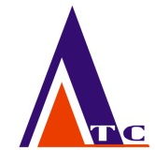


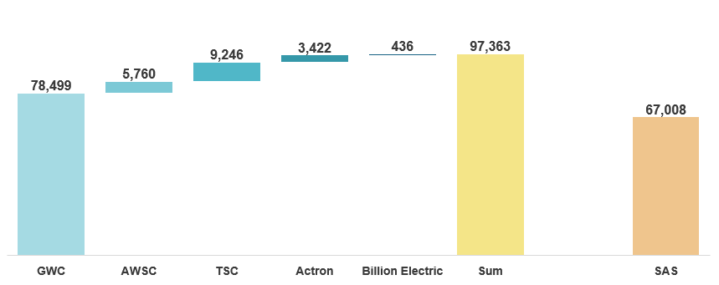
SAS is Undervalued — A Prime Investment Opportunity
SAS’s investment strategy has generated solid value, though its full potential is not yet fully reflected in the market valuation.
SAS is currently trading at a 31% discount to its market value, offering an attractive investment opportunity.
31% discount as of August 4, 2025
(NT$ Million)
Company
SAS Stake
46.6%
28.5%
28.5%
25.6%
12.9%
Source: Taiwan Stock Exchange (TWSE) & Taipei Exchange

Slide 28
03
Industry Overview
26
©Sino-American Silicon Products Inc. All rights reserved.

Slide 29



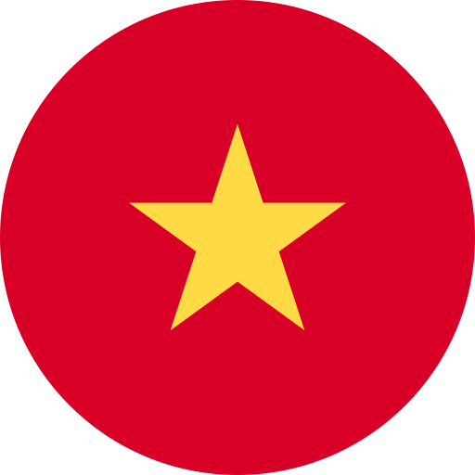

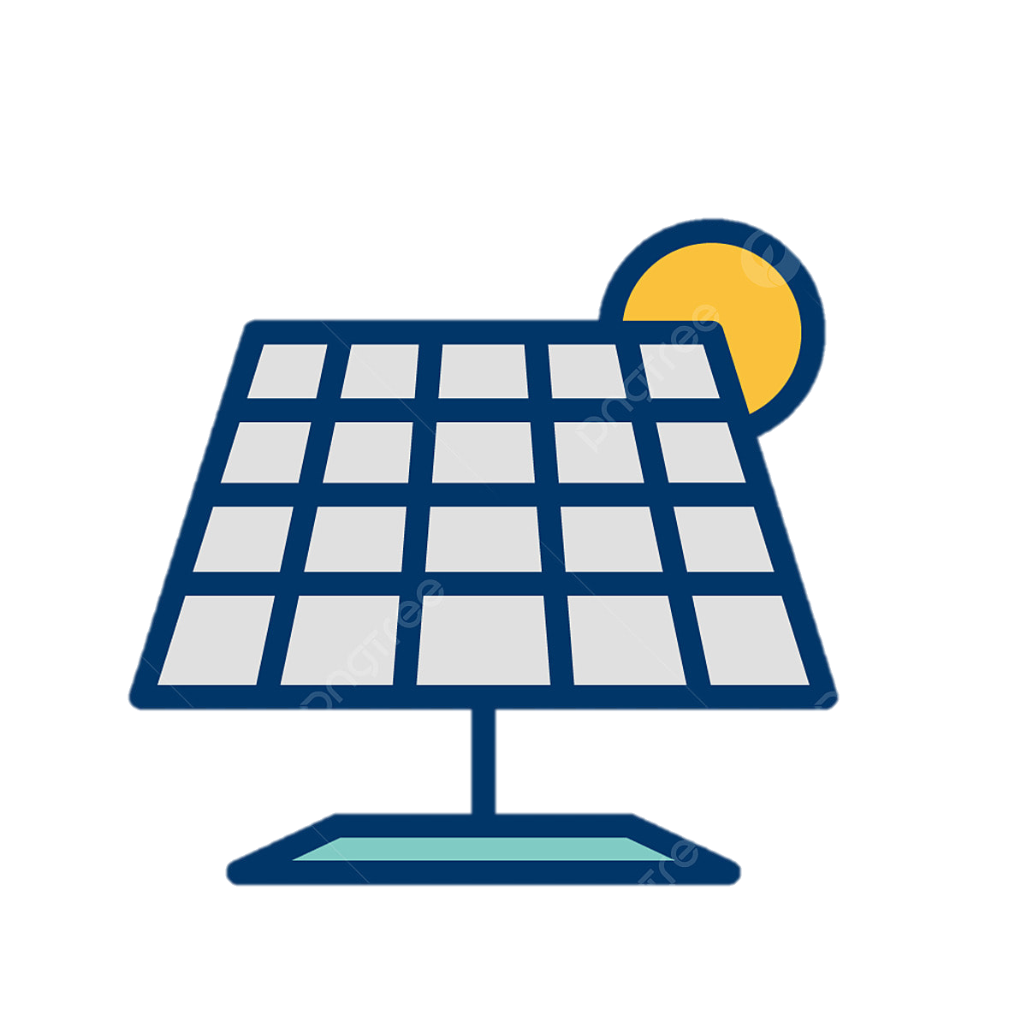

U.S. Solar Tariff Policy Update
After a year-long trade investigation, the U.S. decided in April 2025 to impose anti-dumping and anti-subsidy tariffs on solar products to four Southeast Asian countries (Cambodia, Malaysia, Vietnam, and Thailand). The tariffs varies from different companies and countries, with the highest over 3500%. Recently, the U.S. has launched a new round of solar anti-dumping and anti-subsidy investigations against Indonesia, India, and Laos.
In addition, as the global polysilicon supply is currently concentrated in specific regions, the U.S. Department of Commerce officially launched a Section 232 investigation in early July, focusing on the diversification and security of raw material supply.
U.S. Solar Energy Market
Average AD/CVD Rates on Solar Products – Southeast Asia
Cambodia
651.85%
Malaysia
34.41%
Vietnam
395.85%
Thailand
375.19%
Annual U.S. Solar Module Production Capacity ~50 GW
Crystalline silicon module capacity ~37 GW
Solar cell capacity ~2.5 GW
Under Investigation:
Indonesia, India, and Laos
Source：Digitimes
Note：1. The average AD/CVD rate represents the applicable duty for companies that are not specifically identified in the investigation.
27

Slide 30
Global Renewable Energy Trend
According to the IEA’s newly released World Energy Investment 2025 report, energy security is expected to be a key driver of global energy investment, which is projected to reach a record USD 3.3 trillion in 2025. Of this, clean energy investment is set to reach USD 2.2 trillion, twice the amount allocated to fossil fuels, underscoring the growing shift of capital towards energy transition.
In 2025, global investment in solar PV is projected to reach USD 450 billion, making it the largest single item among all energy technologies and underscoring its leading role in the energy transition. Battery storage investment is also expected to rise to USD 66 billion, reflecting its critical role in enhancing grid resilience and supporting low-carbon power systems.
Global Energy Investment
Global Clean Energy Investment
(Trillion USD)
(Billion USD)
Source: (1) IEA, World Energy Investment 2025, June 2025
28

Slide 31
Taiwan’s Renewable Energy Trend
Taiwan’s energy transition policy aims to increase the share of renewable energy in electricity generation to 30% by 2030, with long-term goal of net-zero carbon emissions by 2050.
Until 2025/04, Taiwan had installed 21.5 GW of renewable energy capacity, with solar PV contributing around 68%(14.3GW) and offshore wind power around 18.5%(3.9GW). To achieve the 2030 target of 31.2 GW and 10.9 GW in solar PV and offshore wind power, an average annual increase in 2.82 GW and 1.17 GW is required. Besides, the target for solar PV installation capacity in 2026 is 20GW.
SAS’s Strategic Layout: SAS Group through its subsidiary SGE, incorporating SES and Anneal, provide the comprehensive green energy services and diverse green energy such as solar, wind, and hydropower. Will become the key partner for industries committed to reducing carbon emissions.
Taiwan Renewable Energy Electricity Generation(%)
Taiwan Renewable Power Generation Capacity, 2021-2035
(%)
Government Goal
(in GW)
Government Goal
Source: Ministry of Economic Affairs of Taiwan, April 2025 ; Taiwan Institute of Economic Research, PV InfoLink, SAS Internal intelligence
Note: 1. Others include onshore wind, hydro, geothermal, biomass, and waste
29

Slide 32
Global Outlook Shifts Amid Trade Policy Uncertainty
Global economic prospects are weakening, with substantial barriers to trade, tighter financial conditions, diminishing confidence and heightened policy uncertainty projected to have adverse impacts on growth.
Inflation may also stay elevated for longer than anticipated, especially if inflation expectations continue to rise. On the upside, an early reversal of recent trade barriers could boost economic growth and help ease inflationary pressures.
Global GDP growth is projected to slow from 3.4% in 2024 to 2.9% in 2025 and 2026, with inflation remaining elevated.
Real GDP Growth for 2024 and Projections for 2025 and 2026
Headline Inflation¹ for 2024 and Projections for 2025 and 2026
(%, year-on-year)
(%, year-on-year)
Global growth is expected to slow
Inflation may prove more persistent than expected
Source: OECD, June 2025
Note: 1. Headline inflation measures the overall change in consumer prices, encompassing all categories including food and energy.
30

Slide 33
Robust 300mm Fab & Advanced Node Growth to 2028
Between 2025 and 2028, 59 new 300mm fabs¹ are set to begin commence operations, raising the total to 249 by 2028. Global 300mm wafer capacity is projected to grow at a 7% CAGR, reaching 11.1 million wafers per month by 2028.
Key growth is driven by advanced process capacity (7nm and below), expected to rise from 0.85 million to 1.4 million wafers per month (wpm) by 2028 (CAGR ~14%). Furthermore, capacity for 2nm and below may increase significantly from under 0.2 million to over 0.5 million by 2028 (CAGR ~36%), driven by strong AI demand.
Global 300mm Wafer Capacity
(K wpm)
(K wpm)
7% CAGR
~14% CAGR
(K wpm)
~26% CAGR
Source: SEMI, June 2025
Note: 1. Include greenfield, shell, volume fabs, high probability
2. Include EPI fabs
31

Slide 34
Financial Highlight : Q225 vs. Q125 vs. Q224
(NT$Mn, except EPS) | Q225 | Q125 | Q224 | QoQ | YoY
Revenue | 20,231 | 19,373 | 19,896 | 4.4% | 1.7%
Gross Profit % | 25.3% | 26.2% | 32.0% | -0.9p.p. | -6.7p.p.
Operating Income | 2,828 | 2,929 | 4,338 | -3.4% | -34.8%
Operating Income % | 14.0% | 15.1% | 21.8% | -1.1p.p. | -7.8p.p.
Net Profit | 1,728 | 1,798 | 3,540 | -3.9% | -51.2%
Net Profit % | 8.5% | 9.3% | 17.8% | -0.8p.p. | -9.3p.p.
EPS¹ | NT$1.17 | NT$1.19 | NT$2.94 | -NT$0.02 | -NT$1.77
EBITDA² | 5,101 | 4,970 | 6,152 | 2.6% | -17.1%
EBITDA % | 25.2% | 25.7% | 30.9% | -0.5p.p. | -5.7p.p.
EBIT³ | 2,139 | 2,190 | 3,681 | -2.3% | -41.9%
ROE⁴ (annualized) | 6.2% | 6.3% | 14.6% | -0.1p.p. | -8.4p.p.
ROA⁵ (annualized) | 3.3% | 2.9% | 5.8% | 0.4p.p. | -2.5p.p.
Note: 1. EPS = Net Profit Attributable To The Shareholders of The Company/Weighted-average Number of Ordinary Shares Outstanding During The Period
2. EBITDA = Net Profit + Tax + Interests + Depreciation + Amortization
3. EBIT = Net Profit + Tax + interests
4. ROE = Net Profit / Average Shareholders Equity
5. ROA = (Net Profit + Interest*(1- Effective Tax Rate))/Average Asset
32

Slide 35
Financial Highlight : 1H25 vs. 1H24
(NT$Mn, except EPS) | 1H25 | 1H24 | YoY
Revenue | 39,604 | 39,589 | 0.0%
Gross Profit % | 25.7% | 31.7% | -6.0p.p.
Operating Income | 5,757 | 8,694 | -33.8%
Operating Income % | 14.5% | 22.0% | -7.5p.p.
Net Profit | 3,526 | 7,497 | -53.0%
Net Profit % | 8.9% | 18.9% | -10.0p.p.
EPS¹ | NT$2.37 | NT$6.35 | -NT$3.98
EBITDA² | 10,071 | 13,055 | -22.9%
EBITDA % | 25.4% | 33.0% | -7.6p.p.
EBIT³ | 4,329 | 8,247 | -47.5%
ROE⁴ (annualized) | 6.4% | 15.4% | -9.0p.p.
ROA⁵ (annualized) | 3.4% | 7.0% | -3.6p.p.
Note: 1. EPS = Net Profit Attributable To The Shareholders of The Company/Weighted-average Number of Ordinary Shares Outstanding During The Period
2. EBITDA = Net Profit + Tax + Interests + Depreciation + Amortization
3. EBIT = Net Profit + Tax + interests
4. ROE = Net Profit / Average Shareholders Equity
5. ROA = (Net Profit + Interest*(1- Effective Tax Rate))/Average Asset
33

Slide 36
Revenue
Revenue
(NT$ Mn)
Note: 1. Upon completion of GWC’s acquisition of SunEdison Semiconductor (“SEMI”) in 2016, FY2016 financials has included earnings from SEMI from the period of 02 Dec 2016 – 31 Dec 2016
34

Slide 37
Gross Profit
Gross Profit
(NT$ Mn)
Note: 1. Upon completion of GWC’s acquisition of SunEdison Semiconductor (“SEMI”) in 2016, FY2016 financials has included earnings from SEMI from the period of 02 Dec 2016 – 31 Dec 2016
2. Gross profit increased if excluding the mark-to-market valuation changes on its holdings of Siltronic shares and assuming no major expansion projects were undertaken
35

Slide 38
Operating Income
Operating Income
(NT$ Mn)
20.8%²
21.1%²
16,475²
8,167²
Note: 1. Upon completion of GWC’s acquisition of SunEdison Semiconductor (“SEMI”) in 2016, FY2016 financials has included earnings from SEMI from the period of 02 Dec 2016 – 31 Dec 2016
2. Operating Income increased if excluding the mark-to-market valuation changes on its holdings of Siltronic shares and assuming no major expansion projects were undertaken
36

Slide 39
Net Profit
Net Profit
(NT$ Mn)
Note: 1. Upon completion of GWC’s acquisition of SunEdison Semiconductor (“SEMI”) in 2016, FY2016 financials has included earnings from SEMI from the period of 02 Dec 2016 – 31 Dec 2016
2. Net Profit increased if excluding the mark-to-market valuation changes on its holdings of Siltronic shares and assuming no major expansion projects were undertaken
37

Slide 40
EPS
EPS
(NT$)
12.31²
3.88²
Note: 1. Upon completion of GWC’s acquisition of SunEdison Semiconductor (“SEMI”) in 2016, FY2016 financials has included earnings from SEMI from the period of 02 Dec 2016 – 31 Dec 2016
2. EPS increased if excluding the mark-to-market valuation changes on its holdings of Siltronic shares and assuming no major expansion projects were undertaken
38

Slide 41
Income Statement
(NT$ Mn) | 2024 | Q125 | Q225 | 1H25 | 1H25 simulated¹
Revenue | 79,679 | 19,373 | 20,231 | 39,604 | 38,665
Growth (%) | -2.8% | -1.6% | 1.7% | 0.0% | -
Gross Profit | 24,275 | 5,073 | 5,123 | 10,196 | 11,904
Gross Profit Margin (%) | 30.5% | 26.2% | 25.3% | 25.7% | 30.8%
EBITDA | 22,313 | 4,970 | 5,101² | 10,071 | 13,564
EBITDA Margin (%) | 28.0% | 25.7% | 25.2% | 25.4% | 35.08%
Operating Income | 16,114 | 2,929 | 2,828 | 5,757 | 8,167
Operating Profit Margin (%) | 20.2% | 15.1% | 14.0% | 14.5% | 21.12%
Profit before Tax | 14,732 | 2,551 | 2,411 | 4,961 | 8,454
Profit before Tax Margin (%) | 18.5% | 13.2% | 11.9% | 12.5% | 21.86%
Net Profit | 11,609 | 1,798 | 1,728² | 3,526 | 6,078
Net Profit Margin (%) | 14.6% | 9.3% | 8.5% | 8.9% | 15.72%
EPS (NT$) | 9.24 | 1.19 | 1.17 | 2.37 | 3.88
Note: 1. Simulated figures exclude impacts from GlobalWafers major expansions in the U.S., Italy, and Japan, as well as mark-to-market changes on Siltronic shares
2. Gross margin, EBITDA and net profit decreased due to higher depreciation from GlobalWafers expansions
39

Slide 42
Balance Sheet
(NT$ Mn) | 2023 | 2024 | Q125 | 1H25
Assets
Cash and cash equivalents | 30,828 | 54,1371 | 43,374 | 36,396¹
Account receivable | 12,228 | 12,592 | 13,127 | 12,425
Inventories | 12,556 | 13,976 | 14,598 | 12,932
Property, plant and equipment | 89,668 | 137,3622 | 146,673 | 132,513²
Other assets | 80,216 | 53,2653 | 56,741 | 57,490
Total assets | 225,495 | 271,331 | 274,513 | 251,756
Liabilities
Short-term loan | 47,427 | 31,277 | 38,456 | 31,171³
Account payable | 5,959 | 6,069 | 5,557 | 4,959
Long term loan | 17,169 | 42,9174 | 44,842 | 46,798³
Other liabilities | 72,946 | 75,513 | 71,411 | 61,800⁴
Total liabilities | 143,501 | 155,777 | 160,266 | 144,729
Shareholder equity | 81,994 | 115,555 | 114,247 | 107,027⁵
Cash-related other assets include below items from the subsidiary, GlobalWafers:
(NT$ Mn) | 1H25
Deposits in banks held for three months or more | ^{3,610}
Guarantee for bank financing projects | 18,882
Note | 5,831
Note: 1. Q225 Cash and cash equivalents decreased – partly due to debt repayments using available cash from GlobalWafers
2. Property, plant and equipment decreased – due to subsidies, and currency translation from GlobalWafers
3. Short-term loan decreased & Long-term loan increased – mainly due to debt restructuring from GlobalWafers
4. Other liabilities decreased – primarily due to lower prepaid expenses and FX fluctuations on prepayments from GlobalWafers
5. Shareholder equity decreased – primarily due to FX fluctuation from GlobalWafers
40

Slide 43
05
ESG Highlight
41
©Sino-American Silicon Products Inc. All rights reserved.

Slide 44




Environment Aspect: Dedicated to Green Energy
To support Taiwan in achieving net zero emissions through practical actions, SAS commits to achieving 100% renewable energy usage across all its global operational bases by 2050.
SAS and its affiliates are dedicated to advancing business growth while minimizing environmental impact through initiatives like energy and water conservation and enhanced resource efficiency, reinforcing their long-term ESG commitment.
20%
35%
50%
100%
2030
2035
2040
2050
Carbon
Removal
Improve
Energy Efficiency
Purchase Carbon
Offset Products
Adopt
Renewable Energy
Carbon Intensity (Carbon Emission / Revenue)
Total Water Consumption
(tonCO2e)
(tonCO₂e / KNTD)
(10⁶ L)
42

Slide 45
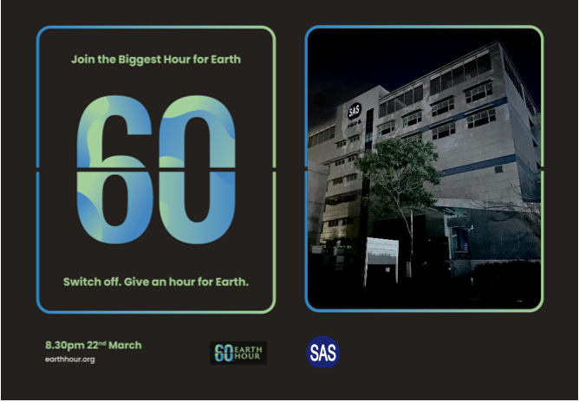

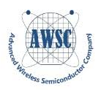


Environment Aspect: Earth Hour 60
SAS, together with its subsidiary GlobalWafers and affiliated companies including AWSC, TSC, and Actron, jointly participated in the world’s largest voluntary energy-saving movement, “Earth Hour 60,” at 8:30 PM Taiwan time on March 22, 2025. By turning off non-essential lighting and power-consuming equipment for one hour, the group demonstrated its concrete commitment to energy conservation, carbon reduction, and protecting the planet.
43

Slide 46
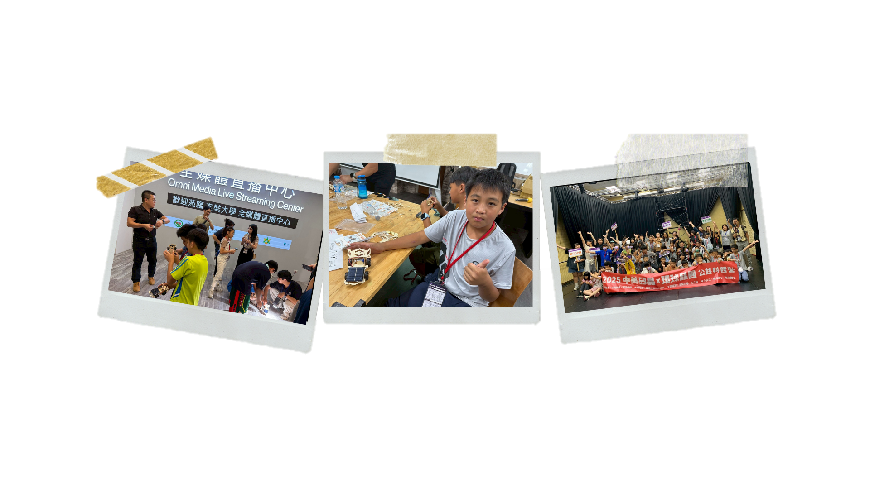
Social Aspect: Corporate Social Responsibility
SAS and GlobalWafers co-organized the 2025 “Pioneer Seedling Program – Charity Science Camp” with IC Broadcasting, IShare Community Development Association, and Hsuan Chuang University, supporting rural education and promoting renewable energy awareness. Guided by the principle of “caring for society and sustainable development,” SAS and GlobalWafers remain committed to supporting rural communities, fostering scientific talent, and advancing renewable energy education.
As part of the program, SAS’s subsidiary SES led a course titled “Get Moving With Renewable Energy,” combining energy education with hands-on DIY solar car activities that planted the seeds of sustainability in young minds.
44

Slide 47






Governance Aspect: Responsible Growth
SAS has been ranked among the top 5% of all TPEx-listed companies in the Corporate Governance Evaluation for the eleventh consecutive year. With a total of 977 companies participating in the 2024 assessment, this distinction highlights our unwavering commitment and consistent efforts in key areas such as board governance, information transparency, shareholder rights protection, and sustainable development.
Group subsidiary GlobalWafers, along with affiliated companies Actron and AWSC, were also ranked among the top 5% of all TPEx-listed companies, demonstrating the group’s overall excellence in corporate governance.
Engaging an independent external institution to conduct board performance evaluations
The Yilan site passed the RBA VAP audit and received the Silver Award
Consistently certified at TIPS A-Level for multiple consecutive years
Two-time recipient of Hsinchu Science Park’s excellence award for promoting workplace equality
CDP 2024 water security: A- (Leadership Level)
45

Slide 48
06
GlobalWafers
46
©Sino-American Silicon Products Inc. All rights reserved.

Slide 49
Income Statement (GlobalWafers)
(NT$ Mn) | 2024 | Q125 | Q225 | 1H25 | 1H25 (simulated)¹
Revenue | 62,626 | 15,595 | 16,008 | 31,602 | 30,663
Growth (%) | -11.4% | 3.4% | 4.5% | 3.9% | -
Gross Profit | 19,804 | 4,112 | 4,123 | 8,235 | 9,962
Gross Profit Margin (%) | 31.6% | 26.4% | 25.8%³ | 26.1% | 32.5%
EBITDA | 18,010 | 4,033 | 4,472 | 8,505 | 11,396
EBITDA Margin (%) | 28.8% | 25.9% | 27.9%⁴ | 26.9% | 37.2%
Operating Income | 14,118 | 2,589 | 2,438 | 5,027 | 7,031
Operating Profit Margin (%) | 22.5% | 16.6% | 15.2% | 15.9% | 22.9%
Profit before Tax | 12,429 | 2,133 | 2,289 | 4,422 | 7,313
Profit before Tax Margin (%) | 19.8% | 13.7% | 14.3% | 14.0% | 23.8%
Net Profit | 9,839 | 1,456 | 1,682 | 3,138 | 5,216
Net Profit Margin (%) | 15.7% | 9.3% | 10.5% | 9.9% | 17.0%
EPS (NT$) | 21.06 | 3.05 | 3.52 | 6.56 | 10.91
Note: 1. Simulated figures exclude impacts from major expansions in the U.S., Italy, and Japan, as well as mark-to-market changes on Siltronic shares
2. Growth figures represent year-over-year (YoY) changes
3. Q2 2025 gross margin declined QoQ due to higher depreciation from expansions
4. Q2 2025 EBITDA margin increased QoQ mainly from mark-to-market gains on Siltronic shares
47

Slide 50
Balance Sheet (GlobalWafers)
(NT$ Mn) | 2023 | 2024 | Q125 | 1H25
Assets
Cash and cash equivalents | 26,165 | 38,929 | 28,846 | 22,220¹
Account receivable | 10,116 | 10,265 | 10,845 | 10,140
Inventories | 9,359 | 11,238 | 11,953 | 10,303
Property, plant and equipment | 72,251 | 119,074 | 128,495 | 114,496²
Other assets | 71,097 | 45,074 | 47,987 | 49,201
Total assets | 188,988 | 224,581 | 228,126 | 206,361
Liabilities
Short-term loan | 40,000 | 28,797 | 32,275 | 24,287¹
Account payable | 5,027 | 5,371 | 4,433 | 3,804
Long term loan | 14,542 | 37,648 | 39,699 | 43,055¹
Other liabilities | 62,966 | 61,706 | 60,043 | 50,334³
Total liabilities | 122,534 | 133,553 | 136,449 | 121,480
Shareholder equity | 66,454 | 91,028 | 91,677 | 84,881⁴
Cash-related other assets include:
(NT$ Mn) | 1H25
Deposits in banks held for three months or more | ^{3,610}
Restricted Cash | 18,882
Note | 5,831
Note: 1. Q225 Cash and cash equivalents decreased – partly due to debt repayments using available cash
2. Short-term loan decreased & Long-term loan increased – mainly due to debt restructuring
3. Q225 Property, plant, and equipment decreased – due to subsidies, depreciation, and currency translation
4. Q225 Other liabilities decreased – primarily due to lower prepaid expenses and FX fluctuations on prepayments
5. Q225 Shareholder equity decreased – primarily due to FX fluctuation
48

Slide 51
07
Q&A
49
©Sino-American Silicon Products Inc. All rights reserved.

Slide 52
Q&A via Slido
Step1 Step2 Step3
2. A Slido interface will be presented.
1. Click OK upon seeing "GWCIR wants
to open Slido in the meeting“.
3. Input your questions.
If you exit Slido and wish to re-enter the platform:
Please note：
1. Inputting questions in English is suggested.
2. Sending all questions in one go is suggested.
3. Questions will be taken during the Q&A session.

Slide 53
Q&A via Audio
Step1 Step2 Step3
Click on the icon with three dots on the lower right.
Click “Raise your hand" on the upper left.
Unmute yourself to ask questions upon receiving our invitation.
Please note：
Questions will be taken during the Q&A session.

Slide 54

Thank You!
Learn More on
Our Website
©Sino-American Silicon Products Inc. All rights reserved.

